Slide 1
Strategic Excellence
Dr. Marwa Tarek
4th class
Internal Strategic Management Audit

Slide 2
Internal Strategic Management Audit

Slide 3
Nature of an Internal Audit
when can I consider a positive issue that the company has as a strength?
If my competitors don’t have the same issue it can be considered as a strength in the near future as I can capitalize on it to give me an advantage in the market, in the competition and to help me in achieving my vision and mission. So, if they have the same advantage, I cannot consider it as one of my strengths.
While developing the list of strengths, I have to ensure that my competitors haven't the same advantage or they may find it very difficult and it will take a long time to copy or to imitate.
Ex: if one of the organizations has a very strong financial position. If another organization has also a strong financial position, so you cannot include it as one of your strengths.

Slide 4
Nature of an Internal Audit
Why do we need to conduct the internal audit?
Because based on….
Internal strengths/weaknesses; coupled with
External opportunities/threats; and
Clear statement of mission.
I will be able to develop the organizational objectives and concrete strategies.

Slide 5
Nature of an Internal Audit
Internal strengths means:
Unique/Distinctive Competencies:
Firm’s strengths that cannot be easily matched or imitated by competitors
I need to know my strengths on which I can capitalize to compete in the market.

Slide 6
Internal Audit (Internal +ves and –ves)
Internal audit is a parallel process of the external audit.
It focuses on identifying strengths and weaknesses in 3 categories;
1- Management functions
( Planning- Organizing- Leading- Controlling).
2- Business functions; such as
Marketing
Finance/Accounting
Production/Operations
Research & Development
Management Information Systems
In order to have the appropriate business function I have to use properly the related mgt function (ex. HR planning) means I m planning HR,so we link the business function (HR) with the mgt function (Planning) in order to help the organization to succeed in the market.
3- Resources that the company has an access to (e.g. financial rescources, HR,….).
Any one of these three main issues could be a source of strengthes or weaknesses

Slide 7
Internal Audit (Internal +ves and –ves)
Resources that the company has an access to can be classified into two groups:
1- Traditional resources: they can be divided into:
Physical resources (building).
Monetary resources (cash, accounts recievables).
2- Intellectual capital resources can be divided into:
Human capital resources (not HR): refers to features and attributes that people have and cannot replaced by machines (knowledge, the level of motivation, experiences, skills, abilities, training, etc…).
Relational resources: the relationship between the organization itself and the stakeholders (customers, suppliers, creditors, government, competitors).
Organizational resources: the structure of the company, the culture, processes, information systems, procedures, regulations, policies, etc…..
When I audit company internally I have to audit all of them.

Slide 8
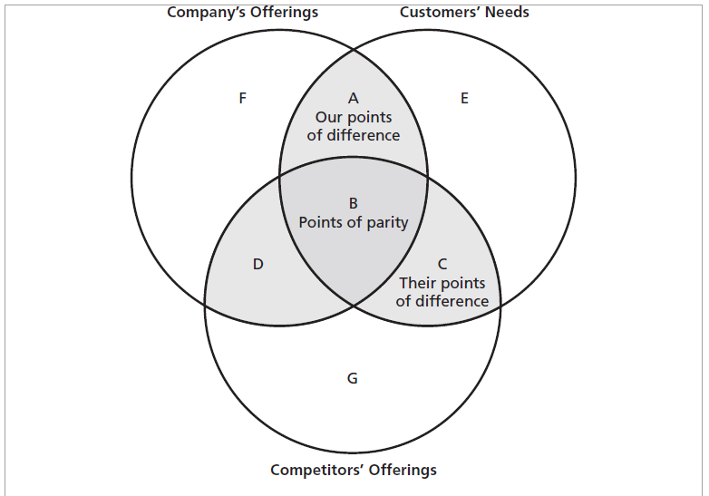
Three Circles Analysis
Internal analysis technique: Three Circles Analysis
Point A: means my company’s offerings that meet customers’ needs and the competitors are not offering.
Point C: means my competitor’s offerings that meet customers’ needs and my company is not offering.
Point B: means common company’s and competitor’s offerings that meet customers’ needs.
Point D: means my company’s and competitor’s offerings that are not meeting customers’ needs.
Point G: means my competitor’s offerings that are not offered by my company and are not meeting customers’ needs.

Slide 9
Three Circles Analysis
How can I use the three circles analysis in developing the list of strengths and weaknesses?
Strengths: comes from point A.
Weaknesses: come from point C.
The main advantages of the three circles analysis:
It helps the organization to focus on the main issues that the organization has to attention to, in order to meet the customers’ needs and achieving the customers’ loyalty and high satisfaction for survival, growth and achieving profitability.
Benchmarking, or comparing the way “our” company performs a specific activity with a competitor or other company doing the same thing, has become a central concern of managers in quality commitment companies worldwide.

Slide 10
Three Circles Analysis (contd.) Questions to Ask About Each Circle
Circle A
How big and sustainable are our advantages?
Are they based on distinctive capabilities?
Circle B
Are we delivering effectively in the area of parity?
Circle C
How can we counter our competitors’ advantages?

Slide 11
Nature of an Internal Audit
How can I conduct the internal audit?
Internal Factor Evaluation (IFE) Matrix
1.List key internal factors as identified in the internal-audit process
2.Assign a weight that ranges from 0.0 (not important) to 1.0 (all-important) to each factor
3.Assign a rating to each factor to indicate whether that factor represents a strength or weakness
4.Multiply each factor’s weight by its rating to determine a weighted score for each variable
5.Sum the weighted scores for each variable to determine the total weighted score for the organization.

Slide 12
Nature of an Internal Audit
How can I conduct the internal audit rating?
There are two main techniques:
First- to handle rating as EFE (rating: 1,2,3,4). These 4 no. could be used to rate any single strength and any single weakness.
Second- as far as strengths exist, so when we are rating them, we have to stick to either 3(minor strength) or 4 (major strength).
As far as weaknesses exist, so when we are rating them, we have to stick to either 1(major weakness) or 2 (minor weakness).
In our analysis we will use the second technique.

Slide 13
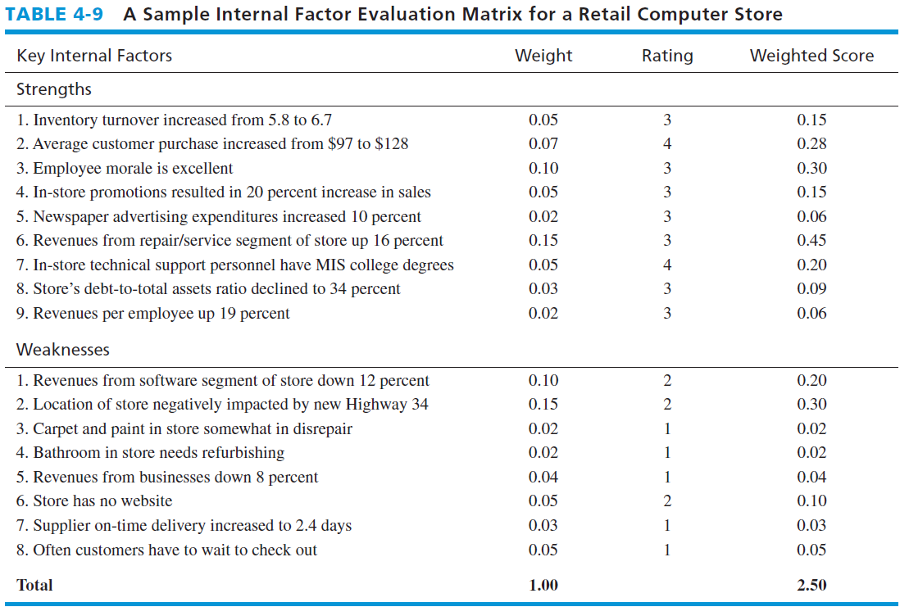
A Sample Internal Factor Evaluation Matrix for a Retail Computer Store

